Slide 1


Week 06 – Cross Validation Engr. Misbah Perveen

Slide 2
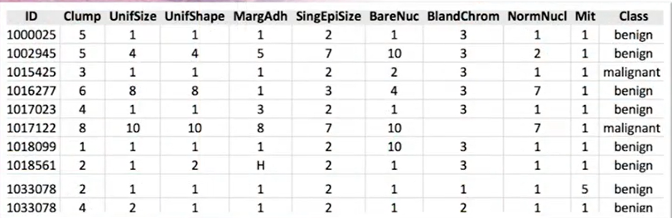
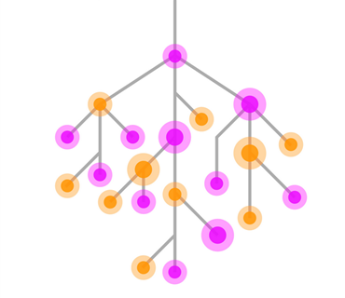
Data Mining helps with prediction
Modeling
Benign
Prediction
Accuracy 89%

Slide 3
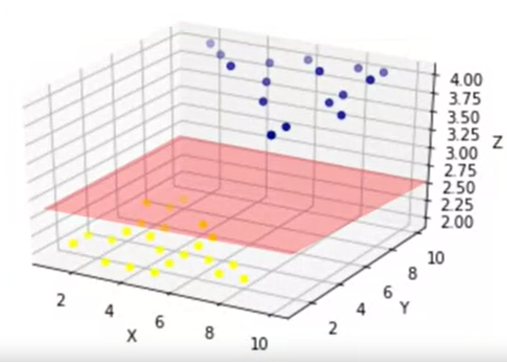
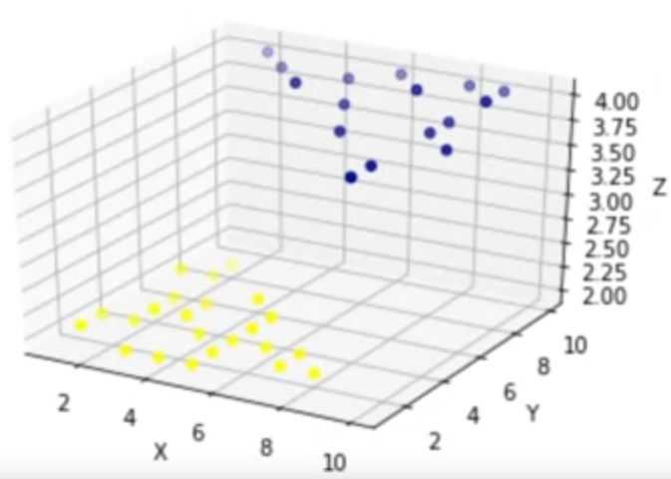
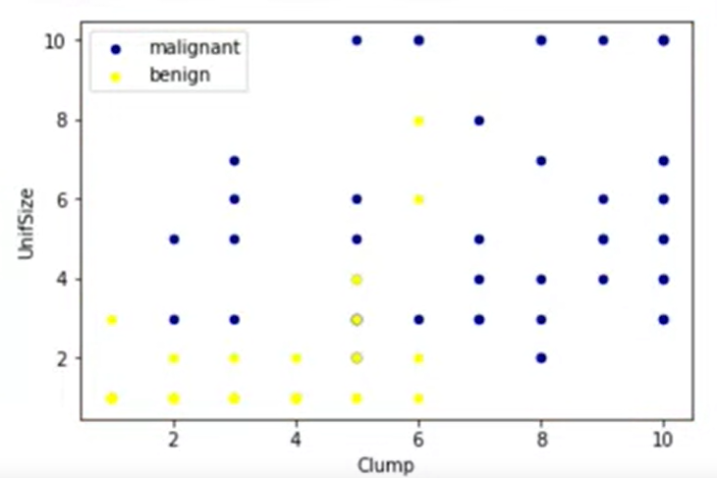
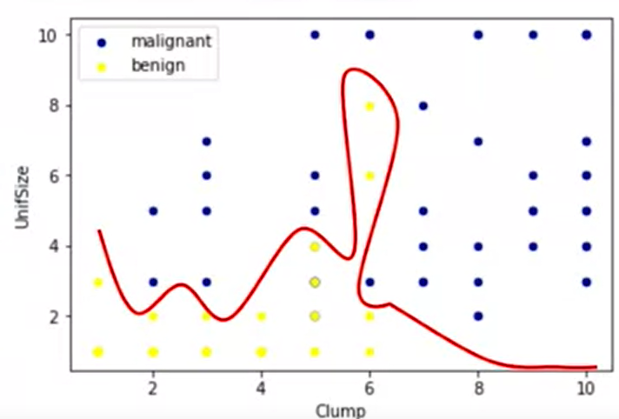
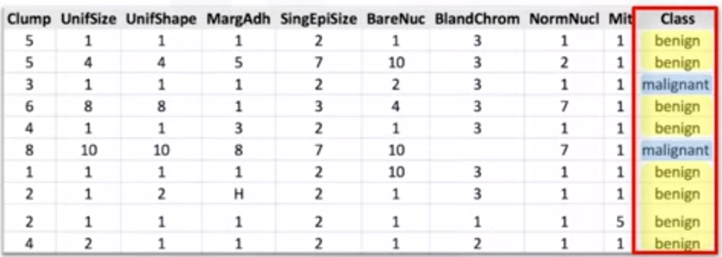
What is SVM?
SVM is a supervised algorithm that classifies cases by finding a separator.\
Mapping data to a high-dimensional feature space
Finding a separator
Higher dimensional space
Linearly non separable data
Hyperplane

Slide 4
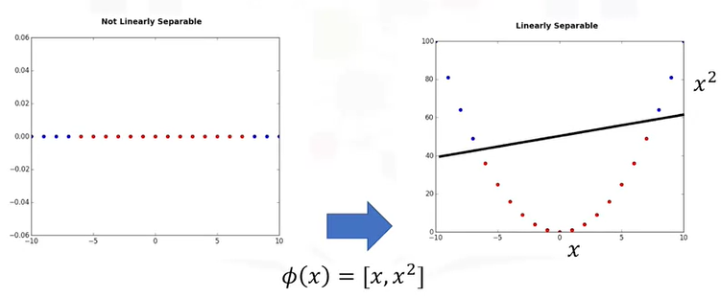
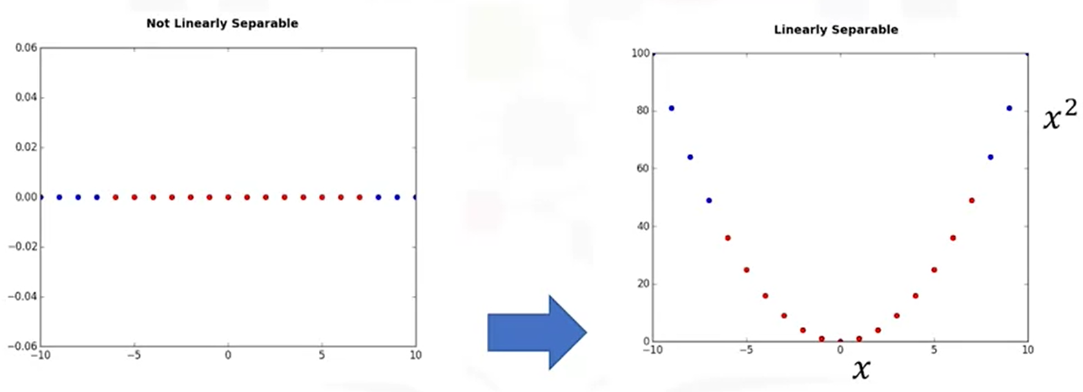
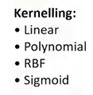

Data Transformation

Slide 5
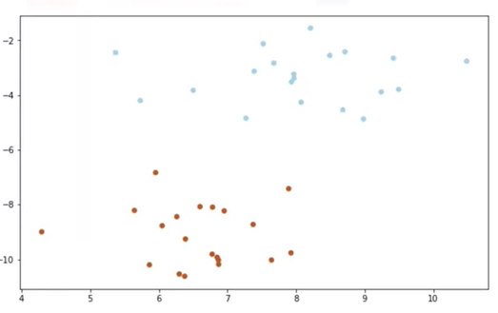
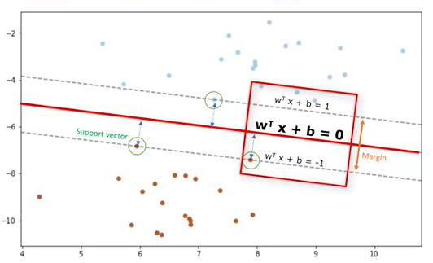

Using SVM to find the hyperplane
Support Vectore
hyperplane
Margin

Slide 6
Pros and cons of SVM
Advantages:
Accurate in high-dimensional spaces
Memory efficient
Disadvantages:
Prone to over-fitting
No probability estimation
small data set

Slide 7
SVM applications
Image classification/ recognition
hand written digit recognition
Text category assignment
Detecting spam
Sentiment analysis
Text mining
Gene Expression classification
Regression, outlier detection and clustering

